Slide 1


Investment analysis of
Talon Hird Acctg 432 November 20, 2024

Slide 2
Recommendation
PE ~ 26
Market Cap ~ 1.45T
Long Term Hold…
Strengths
Exceptional cash flow generation and profit margins
Dominant social platforms with billions of users
Significant AI and metaverse growth potential
Risks
Intense regulatory scrutiny over data practices
Large Reality Labs R&D losses ($16B 2023)
Mounting legal/privacy challenges across global markets

Slide 3
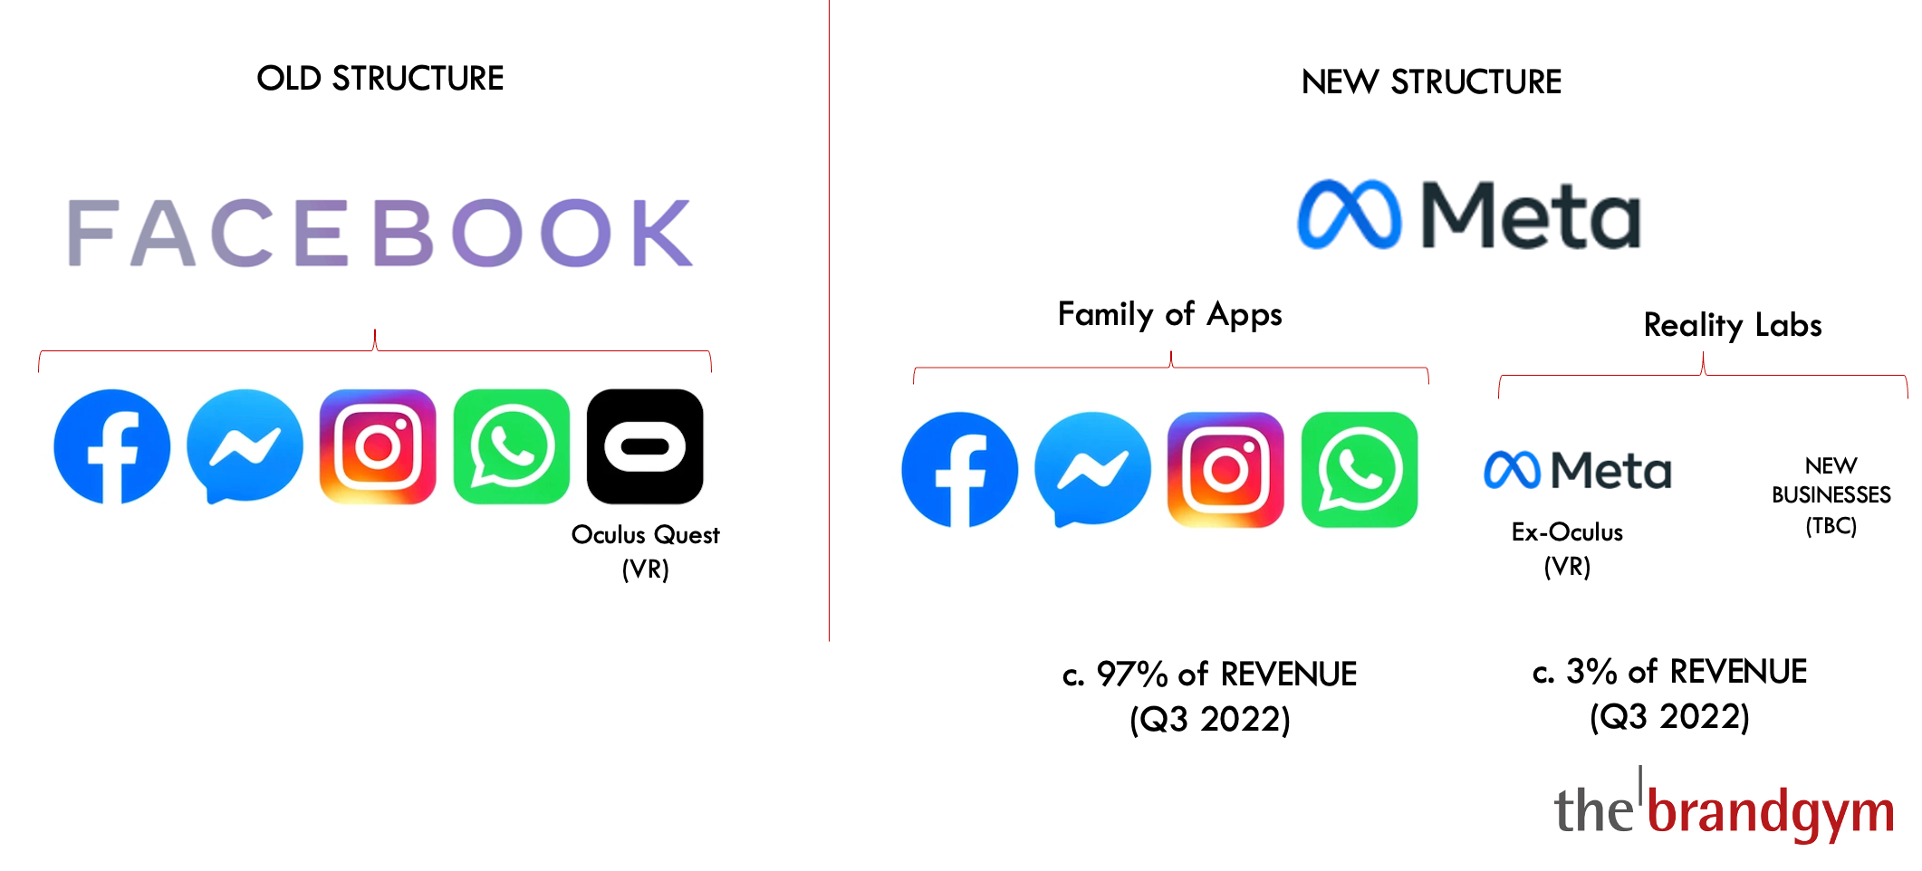
Company Segments
(2021/2022 Change)
Major 2022 Restructuring Costs
$4.61B total charges ($4.10B Family of Apps, $515M Reality Labs)
22% headcount decrease
Consolidated office space, abandoned/subleased properties
Share price tanked from $378 to $91 from Sept 2021 to Nov 2022

Slide 4
Family of Apps Segment
META Reality Labs Segment
Core Business
Facebook, Instagram, Messenger, Whatsapp
3.29 Billion Daily users
Average of $44.60 annual revenue per customer (but growing)
Revenue comes primarily from Advertising
$133.01 billion of revenue in 2023
47% margins (98.6% of Company Revenue)
Focus on developing futuristic AR, VR,
and Metaverse technologies
Eg: Meta Quest, Ray-Ban Meta Smart-Glasses
Only generates $1.9 billion in revenue
16.12 billion in operating loss in 2023
(Massive R&D towards building future tech)
Positions them for leadership in next generation
social technology

Slide 5
2025 Book Value and Revenue Forecast
 | 2025 | 2024 | 2023
Starting BV | 169,126 | 153,168 | 125,713
Comprehensive Income | 63,939 | 59,676 | 40,473
Ending BV | 200,305 | 169,126 | 153,168
Implied Distributions | 32,760 | 43,718 | 13,018
Ratio | 51.2% | 73.3% | 32.2%
Used Q1-Q3 2024 to extrapolate Q4 2024
Then used trends and short term historical averages to project further to 2025
Company does not distribute dividends, does all redistributions in the form of buybacks

Slide 6
2025 Book Value and Revenue Forecast
PPE as Revenue/Growth Predictor
*92% R-Squared*
2025 Projected Revenue: $194B
Based on Current PPE trends

Slide 8
In Millions of $
 |  | 0 | 1 | 2 | 3 | 4 | 5 | 6 | 7
 |  | 2024 | 2025 | 2026 | 2027 | 2028 | 2029 | 2030 | Terminal Value
Revenue Growth |  | 11.0% | 29.6% | 15.0% | 13.0% | 11.5% | 10.0% | 8.5%
Revenue |  | 149,687 | 193,977.79 | 223,074.46 | 252,074.14 | 281,062.67 | 309,168.94 | 335,448.29
CI Margin |  | 39.9% | 33.0% | 32.6% | 32.6% | 32.6% | 32.6% | 32.6%
Comprehensive Income |  | 59,676 | 63,938.76 | 72,636.23 | 82,078.94 | 91,518.02 | 100,669.82 | 109,226.76
Distribution Ratio |  | 28.5% | 46.3% | 46.3% | 46.3% | 46.3% | 46.3% | 46.3%
Distributions |  | 17,033 | 29,583 | 33,607 | 37,976 | 42,343 | 46,577 | 50,536
Book Value of Equity |  | 169,126 | 203,482.01 | 242,511.30 | 286,614.41 | 335,789.38 | 389,881.84 | 448,572.16
ROE |  | 47.5% | 37.8% | 35.7% | 33.8% | 31.9% | 30.0% | 28.0%
Required Income |  | 17,384.57 | 19,195.81 | 23,095.21 | 27,525.03 | 32,530.74 | 38,112.09 | 44,251.59
Residual Income |  | 59,676 | 44,743 | 49,541 | 54,554 | 58,987 | 62,558 | 64,975 | 5% Terminal Growth
PV Residual Income |  | NA | 40,182.26 | 39,956.23 | 39,514.38 | 38,370.51 | 36,545.16 | 34,088.36 | 1,053,927.93
Discount Rate | 11.4%
Analyst CAPM | 8.5% |  | Long Run ROE | 20-25% | (Trends down for few years and then stabilizes) |  | 5% = Company will eventually go to ~ 3% but likely not for decades
Market Cap @ Nov 15th 2024 Aprox | 1,450,000.00

Slide 9
Year | 2023 | 2022 | 2021 | 2020 | 2019 | 2018 | 2017 | 2016
Users | 2.96B | 2.87B | 2.81B | 2.63B | 2.38B | 2.21B | 1.98B | 1.68B
YoY User Growth | 3.2% | 2.1% | 6.9% | 10.3% | 7.7% | 11.9% | 17.5% | 17.8%
Revenue Per User (Average) | 44.60 | 39.63 | 40.96 | 32.03 | 29.25 | 24.96 | 20.21 | 15.98

Slide 10
Regulation
Big Picture
Meta is facing increasing scrutiny over how they collect and use people's data. Regulators worldwide are tightening rules, forcing the company to change how they make money from advertising. This threatens their core business model of using detailed user data to target ads effectively.
• EU regulations forcing shift to consent-based advertising
• Privacy changes hurting ad targeting effectiveness
• Geographic revenue variations due to regional regulations
• Data sharing restrictions impacting cross-platform monetization
“In particular, legislative and regulatory developments such as the General Data Protection Regulation, including its evolving interpretation through decisions of the Court of Justice of the European Union, ePrivacy Directive, the European Digital Services Act, and U.S. state privacy laws including the California Consumer Privacy Act, as amended by the California Privacy Rights Act, have impacted our ability to use data signals in our ad products, and we expect these and other developments such as the Digital Markets Act will have further impact in the future.”

Slide 11
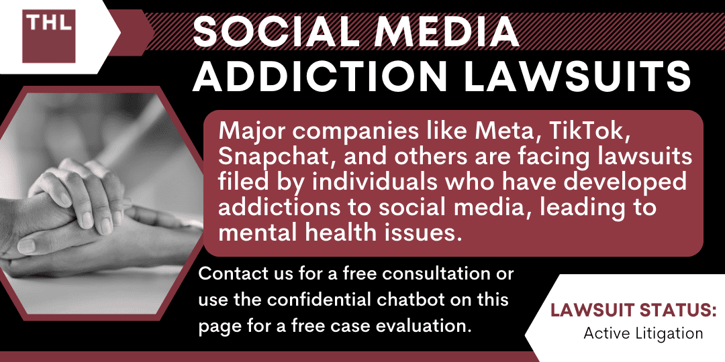

Slide 12
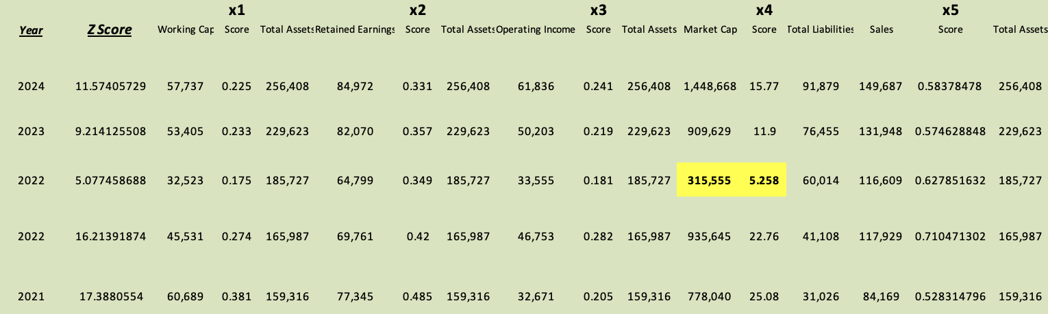
Altman Z
Overall strong financial health. Z score has remained well over danger threshold even during downturn. Very low bankruptcy risk
Large drop in market cap and investor confidence in 2022 after re-branding. Share price has recovered very strong
Working Capital and Total Assets to Retained Earings ratios have remained mostly strong

Slide 13
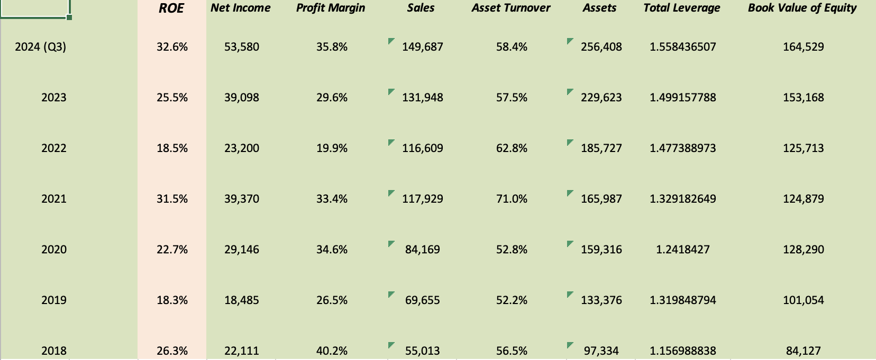
Dupont Analysis
2022 dip in metrics due to Reality Labs rebrand
Leverage has increased slowly and steady which indicates responsible partially debt financed expansion
ROE has climbed to impressive heights at 32.6% primarily driven by increasing profit margin
Overall trend of impressive steady growth and adeptly handled investment/expansion to AR/VR/Metaverse goals

Slide 14
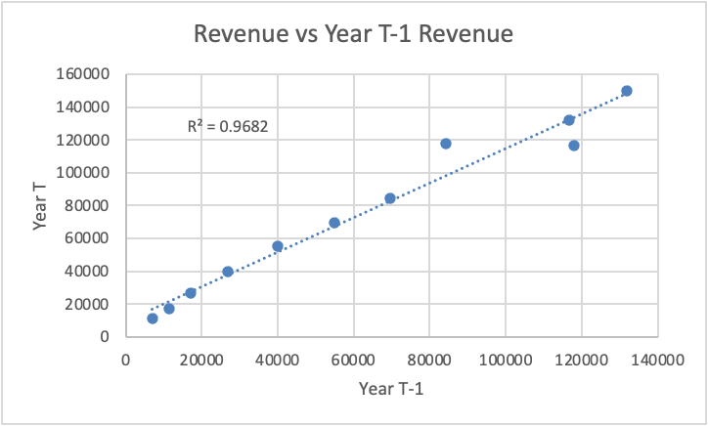
Accounting Quality -
Revenue Regression
R² = 0.971 (97.1% predictability)
Slope coefficient = 1.067 (high persistence)
Statistically significant (p < 0.001)
Strong predictive power of future performance

Slide 15
Operating CF Vs Income
Stable average ~11% over 12+ years
Consistent 6-15% range despite rapid company growth
The consistently higher operating cash flow reflects two major and growing non-cash expenses, share based compensation ($16-17B annually) and depreciation ($14-15B annually).
Supports strong accounting quality despite exceeding 5% benchmark
No Red Flags

Slide 16
References
https://thebrandgym.com/wp-content/uploads/2021/11/screenshot-2021-11-03-at-09.50.21.png
https://www.torhoermanlaw.com/social-media-mental-health-lawsuit/social-media-addiction-lawsuits/

